Slide 1
Data Analysis on endangered species from several different parks Capstone Project
Course: Introduction to Data Analysis
Participant name: Gayathri Rajagopalan
Participant email: gtri87@gmail.com

Slide 2
Index
Description of data
Significance calculations for endangered status between different categories of species.
A recommendation for conservationists, based on significance calculations
Sample size determination for the foot and mouth disease study
Graphs created

Slide 3
Description of data
The data provides conservation related information about various species, including mammals, amphibians, birds, fish, reptiles, vascular and non-vascular plants
It lists their scientific and common names, and their conservation status
On analysis of data, the number of species under each conservation status is as follows:
Endangered: 15
Species of concern: 151
Threatened: 10
In Recovery: 4
No Intervention: 5363

Slide 4
Description of Data(contd.)
On further analysis of data, the conservation status for each category of species is as follows:
Category | Not Protected | Protected
Amphibian | 72 | 7
Bird | 413 | 75
Fish | 115 | 11
Mammal | 146 | 30
Non-vascular plant | 328 | 5
Reptile | 73 | 5
Vascular plant | 4216 | 46

Slide 5
Significance calculations for endangered status between different categories of species.
P-value was calculated using the chi-squared test to find out if certain species were more endangered
Mammals and Birds: Chi-squared test was run on the following contingency table:[[30,146],[75,413]]. Resulting p-value: 0.688
Mammals and Reptiles: Chi-squared test was run on the following contingency table:[[30,146],[5,73]]. Resulting p-value: 0.038

Slide 6
Recommendation
Based on the calculation performed and the results of the chi-squared test, it can be concluded that certain types of species are more likely to be endangered.
Mammals and Birds: Since the p-value(0.688) was greater than 0.05, the difference between percentages of protected mammals and birds is not significant and is due to chance
Mammals and Reptiles: Since the p-value(0.038) was less than 0.05, there is a difference in the percentage of protected mammals and reptiles, that is significant

Slide 7
Sample size determination for the foot and mouth disease study
Given a baseline of 15% occurrence of foot and mouth disease in sheep at Bryce National Park, calculations were performed to ascertain the sample size needed, if scientists wanted to be sure that a >5% drop is observed in cases of foot and mouth disease in the sheep
The following values were used to calculate the sample size:
Baseline=15
Minimum detectable effect=100*5/15(where 5 is the percentage change scientists want to observe with confidence)
Default level of significance=90%

Slide 8
Sample size determination for the foot and mouth disease study(contd.)
From the above values, the sample size was calculated to be 870
Using the above figure for sample size, the number of weeks the scientists would need to spend, to observe enough sheep ,was calculated for Yellowstone National Park and Bryce National Park
For Yellowstone National Park : number of weeks =sample size/507(number of sheep observations)=1 week approximately
For Brice National Park: number of weeks =sample size/250(number of sheep observations)=2 weeks approximately

Slide 9
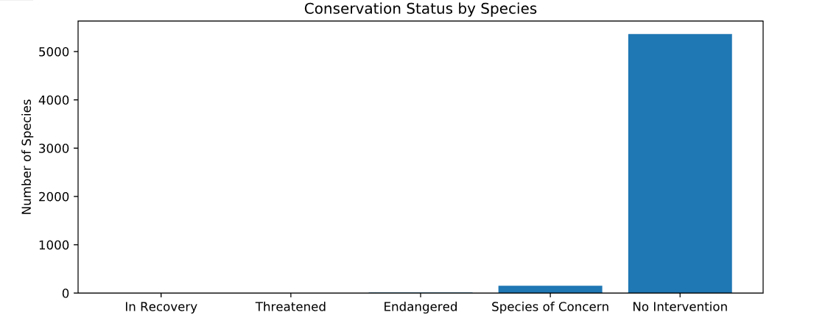
Graph 1 – conservation status by species

Slide 10
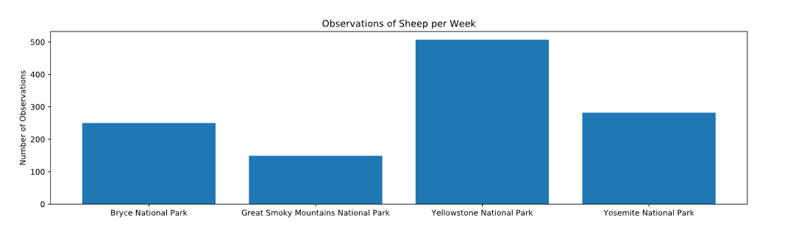
Graph 2 – Weekly sheep sightings per park

